Slide 1
ADHD Medications
Chris McHugh
Kim Ocampo
Sabrina Merry
Hannah Pizzo
Rich Baez

Slide 2
Research Question
What drugs are used?
How do they effect the body?
What are the side effects?
How are the side effects associated with ADD medication affecting the mental development of adolescent users?

Slide 3
Objectives
Understanding ADHD and common treatments and their potential side effects
To further understand how toxins are metabolized and removed from the body
Understand how chiropractic can aid in the management of diagnosed ADHD children

Slide 4


What is ADHD?
Attention deficit hyperactivity disorder (ADHD) is a problem of not being able to focus, being overactive, not being able control behavior, or a combination of these.
For these problems to be diagnosed as ADHD, they must be out of the normal range for a person's age and development.

Slide 5
Symptoms
Not being able to focus (inattentiveness)
Being extremely active (hyperactivity)
Not being able to control behavior (impulsivity)

Slide 6
DIAGNOSIS
If ADHD is suspected, the individual should be evaluated by a health care professional.
There is no test that can make or exclude a diagnosis of ADHD.
The diagnosis is based on a pattern of symptoms.
When the person with suspected ADHD is a child, parents and teachers are usually involved during the evaluation process.

Slide 7
Drugs are the Answer……. : /
Psychostimulants (also known as stimulants) are the most commonly used ADHD medicines.
Although these drugs are called stimulants, they actually have a calming effect in people with ADHD.
For someone with ADHD, stimulants regulate impulsive behavior and improve attention span and focus by increasing the levels of certain chemicals in the brain, such as dopamine and norepinephrine, which help transmit signals between nerves.

Slide 8
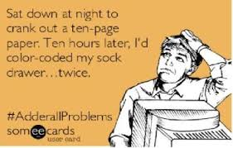

Slide 9
Commonly used medications
Adderall (intermediate-acting)
Adderall XR (long-acting)
Concerta (long-acting)
Dexedrine (short-acting)
Dexedrine spansule (intermediate-acting)
Daytrana (a patch that delivers the drug on a long- or shorter-acting basis)
Metadate CD (long-acting)
Metadate ER (intermediate-acting)
Methylin ER (intermediate-acting)
Ritalin (short-acting)
Ritalin LA (long-acting)
Ritalin SR (intermediate-acting)
Vyvanse
Quillivant XR (long-acting)
The short-acting forms of the drug are usually taken two or three times a day and the long-acting ones just once a day.

Slide 10
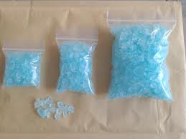
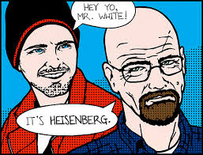
Class II Psychotropic
Meth

Slide 11

Cocaine

Slide 12
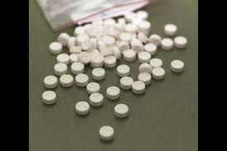
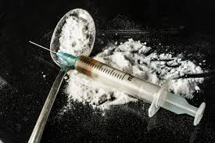
Speed.
Heroin.

Slide 13
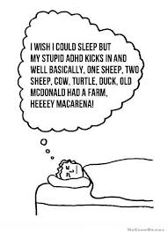
Side Effects
Most Common
Decrease appetite/weight loss
Sleep Problems
Headaches
Jitteriness
Less Common
Cardiovascular problems
Depression
Psychosis
Anxiety

Slide 14
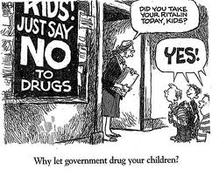

Slide 15
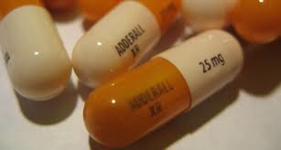
Adderall AKA Amphetamine Mixed Salts Stimulate release of norepinephrine affecting both alpha and beta-adregenic receptor sites.
Immediate and Extended Release
Amphetamine stereoisomer salts
75% dextroamphetamine salts
25% levoamphetamine salts

Slide 16
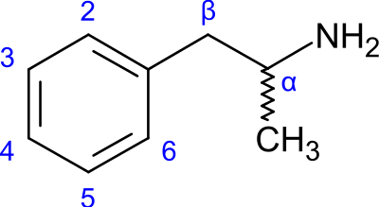
Adderall cont.
Alpha-Adregenic stimulation causes vasoconstriction and an increase in total peripheral resistance.
Beta-Adregenic receptor stimulation leads to an increase in heart rate, stroke volume, and skeletal muscle blood flow

Slide 17
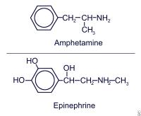
Amphetamines
Similar to cocaine but lasts 10-12 hours, not 10-20 minutes.
The phenylethylamine structure of amphetamines is similar to catecholaminergic, dopaminergic, and serotonergic agonists

Slide 18


Amphetamines in Nature
Amphetamine derivatives occur in nature, for example in the leaves of Ephedra and khat plants.

Slide 19

Breakdown and Excretion
Metabolized primarily via de-esterification to ritalinic acid. The metabolite has little or no pharmacologic activity.
After oral dosing of radiolabeled about 90% of the radioactivity was recovered in the urine.
The main urinary metabolite was ritalinic acid, accounting for approx. 80% of the dose on average.
The half-life for Ritalin in children is about 2.5 hours on average. In adults, the half-life is about 3 to 3.5 hours.
It is important to note that long-acting, slow-release forms will stay in your system longer. The half-lives for these medications are the same, but they will stay in your system longer because they take longer to be absorbed into your body.
Notes:
Esters are chemical compounds consisting of a carbonyl adjacent to an ether linkage
1919

Slide 20
Contraindications
Structural cardiac abnormalities or other serious heart problems
Hypertension or other cardiovascular conditions
Pre-existing psychosis
Seizures
Severe gastrointestinal narrowing

Slide 21
Side-effects
Sudden death
Stroke
myocardial infarction
Psychotic or manic symptoms
Aggression
Priapism
Asthenia
Panic attacks
Sleep disorders
Tics
Erectile dysfunction
Rash
Peripheral vasculopathy
Long-term growth suppression
Visual disturbances
Leukopenia
Shakiness
Sinusitis
Heart rate and blood pressure increase
Anger
Mood swings
Dyspnea

Slide 22
Post-marketing side-effects
Auricular swelling
Bullous conditions
Exfoliative condition
Urticaria
Pruritus
Blood alkaline phosphatase increase
Hepatic enzyme increase
Platelet count decrease
White blood cell count abnormal
Arthralgia
Myalgia
Disorientation
Hallucination
Pancytopenia
Thrombocytopenia
Thrombocytopenic purpura
Angina pectoris
Bradycardia
Diplopia
Mydriasis
Drug effect decreased
Hyperpyrexia
Angioedema
Anaphylactic reactions
Muscle twitching
Grand mal convulsion
Dyskinesia
Erythema

Slide 23
Prevalence
Approximately 11% of children 4-17 years of age (6.4 million) have been diagnosed with ADHD as of 2011
The percentage of children 4-17 years of age taking medication for ADHD, as reported by parents, increased by 28% between 2007 and 2011.
Percentage of children taking medication for ADHD was:
4.8% in 2007
6.1% in 2011
Average annual increase was approximately 7% per year

Slide 24


Target Organ
Brain
Specifically psychostimulant drugs are re-uptake blockades of catecholamines into presynaptic nerve endings.

Slide 25
Mechanism of Action
for Psychostimulants:
Psychostimulants seem to increase the release of certain neurotransmitters - Mostly dopamine and norepinephrine. Research suggests that methylphenidate (such as Ritalin) primarily blocks the reuptake of dopamine and norepinephrine. In essence it slows up how much of the neurotransmitter is being reabsorbed back into the neuron so that more is left in the synapse. And secondarily, methylphenidate seems to facilitate the direct release of neurotransmitter from within the neuron where it is produced and stored therefore sending more out into the synapse space.

Slide 26
Continued
As a result, more of the neurotransmitter is held in the synapse space between neurons long enough for it to properly bind to the receptor, thus messages within the brain are more effectively transmitted and received.

Slide 27
Toxic doses of psychostimulant drugs:
Doses: Adults: Average dosage is 20 to 30 mg daily. Some patients may require 40 to 60 mg daily. In others, 10 to 15 mg daily will be adequate
Children (6 and over): Start with 5 mg twice daily (before breakfast and lunch) with gradual increments of 5 to 10 mg weekly.
Toxic when : Above 60mg per day

Slide 28
Continued
Many doctors seem unaware of the varied nature of stimulant adverse drug reactions. Often they mistake these drug reactions for the surfacing of new psychiatric disorders in the child and mistakenly increase the dose or add further medications, instead of stopping the stimulants.

Slide 29
Continued
Stimulants cause gross brain dysfunction. Methylphenidate, for example, in routine doses caused a 23%-30% drop in blood flow to the brain in volunteers (Wang et al., 1994).

Slide 30
Continued
All stimulants directly disrupt at least three neurotransmitter systems (dopamine, norepinephrine and serotonin). There is strong evidence that stimulant-induced biochemical changes in the brain can become irreversible, especially in regard to amphetamine and methamphetamine, which can cause permanent neurotransmitter system changes and cell death (Battaglia et al., 1987; Melega et al. (1997a, b; Wagner et al., 1980)

Slide 31
One study demonstrated that adults can develop atrophy of the brain after being treated with stimulants as children (Nasrallah et al., 1986). These potentially disastrous irreversible effects have been ignored in most reviews (see details in Breggin, 1998; updated in 1999, in press).

Slide 32
ADHD Drug Warnings:
There have been 44 warnings from eight countries (United States, United Kingdom, Canada, Japan, Australia, New Zealand, France and Singapore) warning that ADHD drugs/stimulants cause harmful side effects. These include the following:

Slide 33
Continued
13 warnings on stimulants causing heart problems
10 warnings on stimulants causing mania/psychosis
9 warnings on stimulants causing cardiovascular problems
8 warnings on stimulants causing death
4 warnings on stimulants causing hallucinations
4 warnings on stimulants causing depression
4 warnings on stimulants causing violence, hostility or aggression
4 warnings on stimulants causing seizures
3 warnings on stimulants causing agitation or irritability
3 warnings on stimulants causing anxiety
2 warnings on stimulants causing suicide risk/attempts
2 warnings on stimulants causing addiction or dependence

Slide 34
ADHD Drug Studies
There are 25 studies from five countries (United States, Australia, Denmark, Canada and Italy) showing that ADHD drugs/stimulants cause harmful side effects. These include the following:

Slide 35
Continued
5 studies on stimulants causing addiction/medication abuse
5 studies on stimulants causing heart problems
5 studies on stimulants showing lack of efficacy of the drug
4 studies on stimulants causing stunted growth
2 studies on stimulants causing death
1 study on stimulants causing suicide risk/attempts
1 study on stimulants causing violence
1 study on stimulants causing homicidal ideation
1 study on stimulants causing irritability
1 study on stimulants causing depression
1 study on stimulants causing mania, psychosis and hallucinations

Slide 36
Citations:
Spiller HA1, Hays HL, Aleguas A Jr. Overdose of drugs for attention-deficit hyperactivity disorder: clinical presentation, mechanisms of toxicity, and management .CNS Drugs. 2013 Jul;27(7):531-43.
Breggin, P.R. (1998). Talking back to Ritalin . Monroe, ME: Common Courage Press
Breggin, P.R. (1999, May, in press). Psychostimulants in the treatment of children: Risks and mechanism of action. Ethical Human Sciences and Services
Melega, W.P., Raleigh, M.J., Stout, D.B., Huang, S.C., & Phelps, M.E. (1997a). Ethological and 6-[18]fluoro-L-DOPA-PET profiles of long-term vulnerability to chronic amphetamine. Behavioural Brain Research , 84, 258-268.
Melega, W.P., Raleigh, M.J., Stout, D.B., Lacan, G., Huang, S.C., & Phelps, M.E. (1997b). Recovery of striatal dopamine function after acute amphetamine- and methamphetamine-induced neurotoxicity in the vervet monkey. Brain Research , 766, 113-20.
Nasrallah, H., Loney, J., Olson., S., McCalley-Whitters, M., Kramer, J., & Jacoby, C. (1986). Cortical atrophy in young adults with a history of hyperactivity in childhood. Psychiatry Research , 17, 241-246.
Wang, G-J, Volkow, N., Fowler, J., Ferrieri, R., Schlyer, D., Alexoff, D., Pappas, N., Lieberman, J., King, P. Warner, D., Wong, C., Hitzemann, R., & Wolf, A. (1994). Methylphenidate decreases regional
cerebral blood flow in normal human subjects. Life Sciences , 54, 143-146.

Slide 37
Effects and Management
The neurological side effects of Adderall® include, but are not limited to, psychotic episodes, overstimulation, restlessness, irritability, insomnia, depression, headache, and motor tics
Increased release of dopamine and norepinephrine, although not completely responsible for the fight or flight response does play a major role in our heightened awareness and attention

Slide 38
Combat Free Radicals
Vitamin C – oranges, blackcurrants, kiwi fruit, mangoes, broccoli, spinach, capsicum and strawberries.
• Vitamin E – vegetable oils (such as wheat germ oil), avocados, nuts, seeds and whole grains.
• Selenium – seafood, offal, lean meat and whole grains.
• Manganese – seafood, lean meat, milk and nuts.
• Copper – seafood, lean meat, milk and nuts.
• Zinc – seafood, lean meat, milk and nuts.
• Beta-carotene – pumpkin, mangoes, apricots, carrots, spinach and parsley.
• Catechins – red wine and tea.

Slide 39
Intervene within a chiropractic model to address the cause of hyperactivity and need for medication to begin with

Slide 40
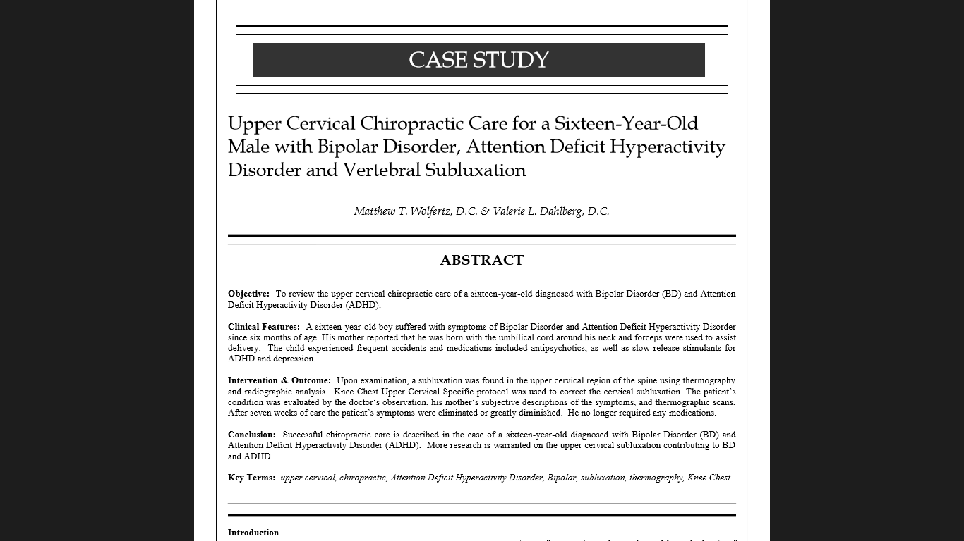

Slide 41
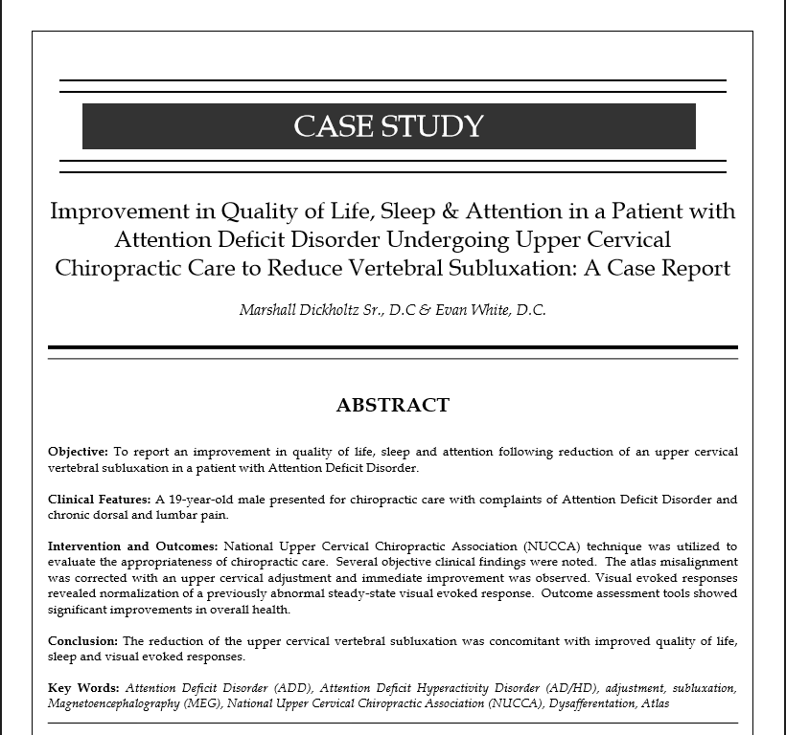

Slide 42
Work Cited
A, S., M, D.-W., F, R., A, R., & J, H. (2006, January). [Genetic background of ADHD: population studies, genes of the catecholamine system]. Retrieved October 5, 2009, from NCBI Pub Med: http://www.ncbi.nlm.nih.gov/pubmed/16756025
Adderall. (n.d.). Retrieved October 5, 2009, from Rx List: The Internet Drug Index: http://www.rxlist.com/adderall-drug.htm
Adderall. (n.d.). Retrieved October 5, 2009, from Drug News: http://www.adderall.net/
Adderall Side Effects. (n.d.). Retrieved October 5, 2009, from Attention Deficit Disorder Help Center.: http://www.add-adhd-help-center.com/adderall_side_effects.htm
Attention-Deficit / Hyperactivity Disorder (ADHD). (n.d.). Retrieved October 5, 2009, from Centers of Disease Control and Prevention: http://www.cdc.gov/ncbddd/adhd/data.html
Biederman, J., Lopez, F., Boellner, S., & Chandler, M. (2002). A randomized, double-blind, placebo-controlled, parallel-group study of SLI381 (Adderall XR) in children with attention-deficit/hyperactivity disorder. Pediatrics , 258-266.
Collier, M. (2008, December 8). Adderall: History, Uses, Side Effects, and Withdrawal. Retrieved October 5, 2009, from Associated Content: Health and Wellness: http://www.associatedcontent.com/article/1268435/adderall_history_uses_side_effects.html?cat=70
Faraone, S., & Biederman, J. (2002). Efficacy of Adderall® for Attention-Deficit/Hyperactivity Disorder: A meta-analysis. Journal of Attention Disorders , 69-75.
Jiao, X. M., Velez, S. M., Ringstad, J. M., Eyma, V. M., Miller, D. M., & Bleiberg, M. M. (2009). Myocardial Infarction Associated with Adderall XR and Alcohol Use in a Young Man. The Journal of the American Board of Family Medicine , 197-201.
LaRue, R. H., Northup, J., Baumeister, A. A., Hawkins, M. F., Seale, L., Williams, T., et al. (2008). An Evaluation of Stimulant Medication on the Reinforcing Effects of Play. Journal of Applied Behavioral Analysis , 141-143.
Methamphetamine Effects. (n.d.). Retrieved October 5, 2009, from Recovery Connection: http://www.recoveryconnection.org/drug_index/methamphetamine.php
Stress: The Fight or Flight Response. (n.d.). Retrieved October 5, 2009, from Psychologist World: http://www.psychologistworld.com/stress/fightflight.php
Surles, L. K., May, H. J., & Garry, J. P. (2002). Adderall-Induced Psychosis in an Adolescent. The Journal of the American Board of Family Practice , 498-500.
Tomlinson, H. (2005). Retraining a Dyslexic Brain. Retrieved October 5, 2009, from Dyslexia Adults Link: http://www.dyslexia-adults.com/t145.html
Woodworth, T. (2000, May 16). DEA Congressional Testimony. Retrieved October 5, 2009, from Drug Enforcement Agency: http://www.usdoj.gov/dea/pubs/cngrtest/ct051600.htm

